Slide 1
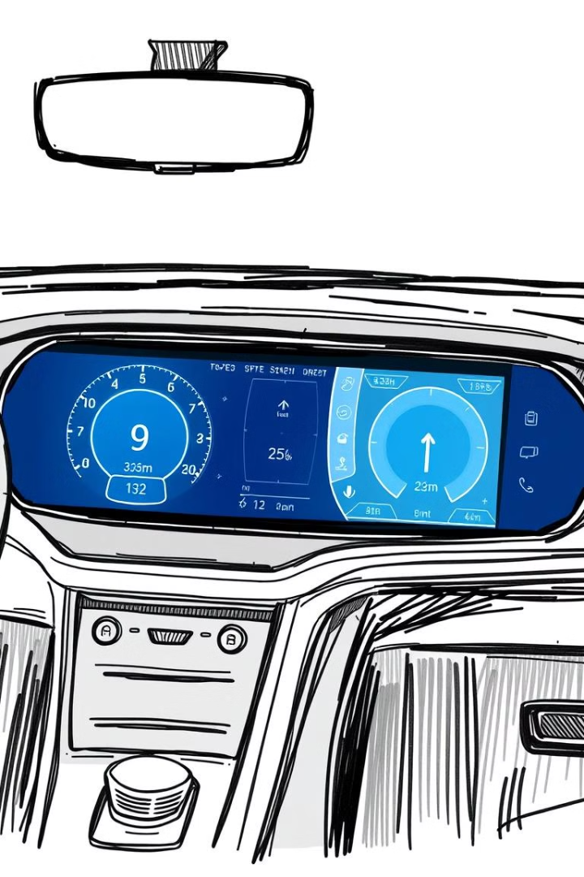
Vehicle Data Input and Efficiency Report Web Application
This web application empowers businesses to track and analyze vehicle data for improved efficiency and cost savings.

Slide 2

Introduction
This web application streamlines vehicle data input and provides comprehensive reports for optimized fleet management.
1
User-Friendly Platform
2
Key Metrics
The platform provides an intuitive interface for data entry and report generation.
The application tracks fuel efficiency, ticket sales, and other crucial metrics.
3
Data-Driven Decisions
4
AI-Powered Insights
Analyze data to make informed decisions about fleet operations.
The AI component provides tailored recommendations for optimizing performance.

Slide 3
Technologies
The application utilizes a robust combination of technologies to deliver a comprehensive solution.
Frontend
Backend
Data Export
HTML/CSS for creating user-friendly forms and reports.
Python (Flask) for data processing, report generation, and data storage.
Users can download data in Excel format for further analysis.

Slide 4

User Input Flow
Users can easily input vehicle and ticket sales data through a user-friendly interface.
Vehicle Data Input
Ticket Sales Entry
Users enter essential vehicle information, such as vehicle number, distance, fuel consumed, and time taken.
Users can link ticket sales data to specific vehicles, enabling comprehensive analysis.
1
2
3
Dynamic Input Fields
The system automatically adds new fields for each vehicle, allowing efficient data entry and updates.

Slide 5




Backend Workflow
The backend processes data, calculates key metrics, and provides insights for improved fleet management.
Data Processing
Once data is submitted, the backend processes it, calculates key metrics, and stores it in a structured format.
Calculation Logic
Fuel efficiency is calculated using distance and fuel consumption data.
AI Integration
The AI component analyzes data patterns to provide optimized suggestions and insights.

Slide 6

Output and Reports
The application generates comprehensive reports for each vehicle, including detailed metrics and visual representations.
Efficiency Report
Detailed report on vehicle performance, fuel efficiency, and other metrics.
Downloadable Data
Users can download reports in Excel format for further analysis.
Graphical Visualization
Visual plots for comparing vehicle efficiency and ticket sales across different vehicles.

Slide 7
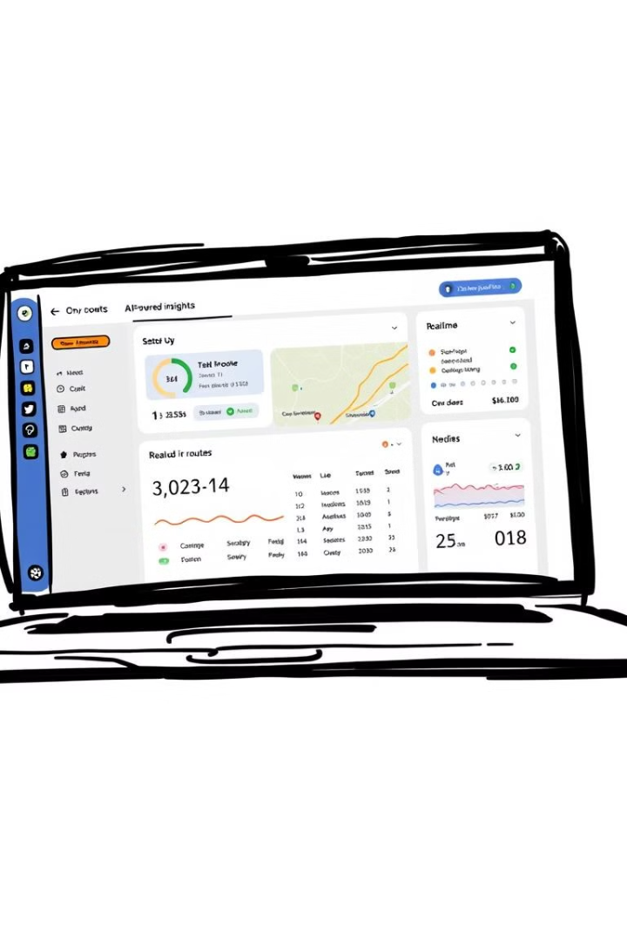



AI-Driven Analysis
The AI component provides actionable insights and recommendations based on collected data.
Fuel Efficiency Optimization
AI analyzes data to suggest improvements for reducing fuel consumption.
Route Planning
AI recommends optimized routes to minimize fuel consumption and travel time.
Maintenance Alerts
The system alerts users to potential maintenance needs based on performance data.

Slide 8

Conclusion
The web application empowers businesses with data-driven insights and AI-powered recommendations for optimized fleet management.
1
Seamless Data Entry
The application provides an intuitive interface for vehicle and ticket sales data input.
2
Efficiency Calculation
Accurate fuel efficiency calculations provide insights into vehicle performance.
3
AI-Powered Insights
The AI component provides actionable recommendations for improved fleet management.

